Slide 1
Research and Innovation in Ontario
Minister of Research and Innovation
The Honourable Reza Moridi

Slide 2
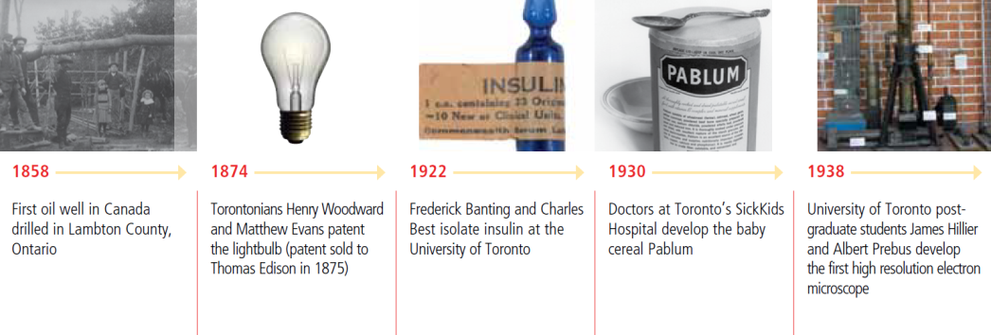
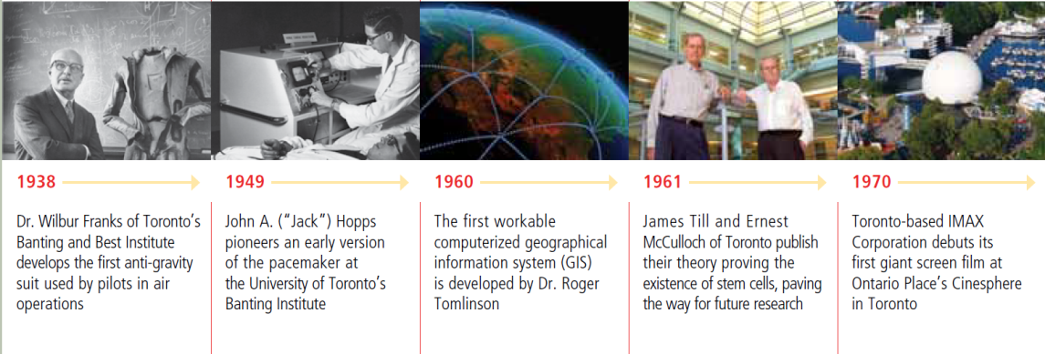
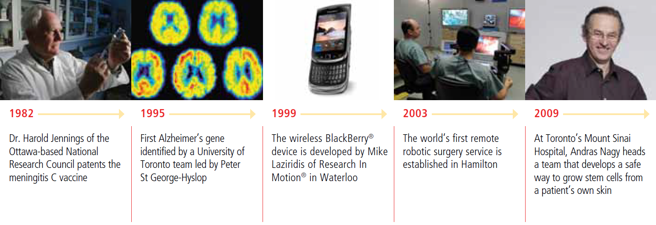
A Strong History of Innovation in Ontario
Notes:
Animation added to slide → Please modify slide if only using print format and not using presentation mode.

Slide 3

Research Institutions
20 Universities
24 Colleges
  Highest post-secondary education rating among G7
  Ontario is home to 6 of Canada’s 15 most research-intensive universities:
    McMaster University
    University of Ottawa
    Queen's University
    University of Toronto
    University of Waterloo
    Western University

Slide 4
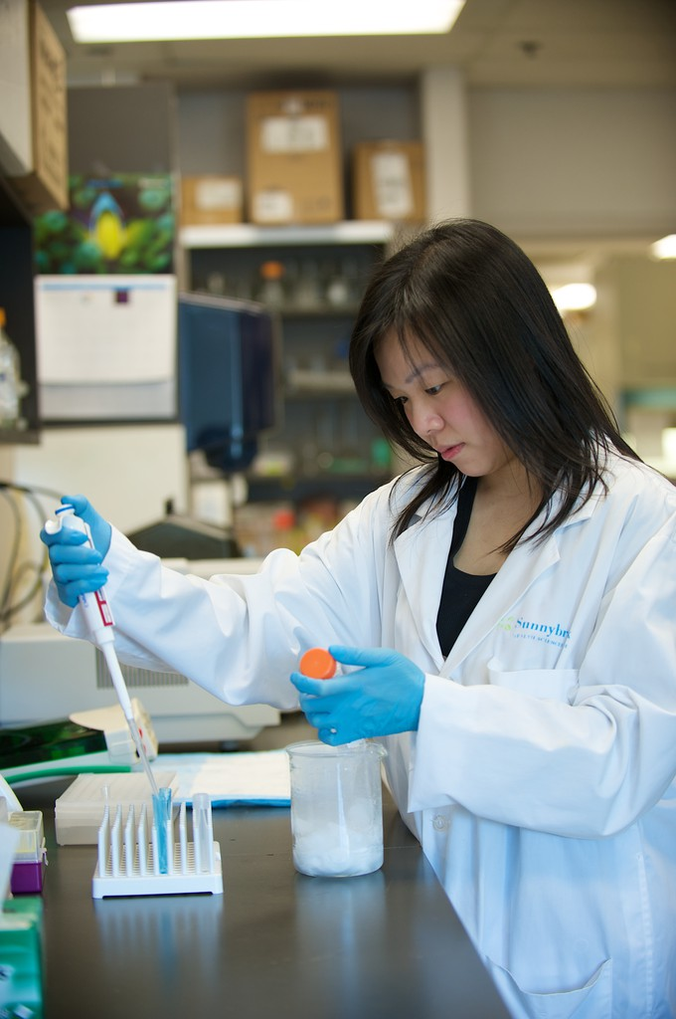
Research Institutions
24 Research Hospitals in Ontario
  St. Josephs Health Care, London
  The Ottawa Hospital
  Hamilton Health Sciences
  University Health Network (UHN)
    Princess Margaret Cancer Centre
    Toronto General Hospital
    Toronto Rehabilitation Institute
    Toronto Western Hospital

Slide 5
Research Institutions
World-Leading Research Institutions
Ontario comprises nearly half of the Canadian
research enterprise, with Ontario research
well-above the world average

Slide 6
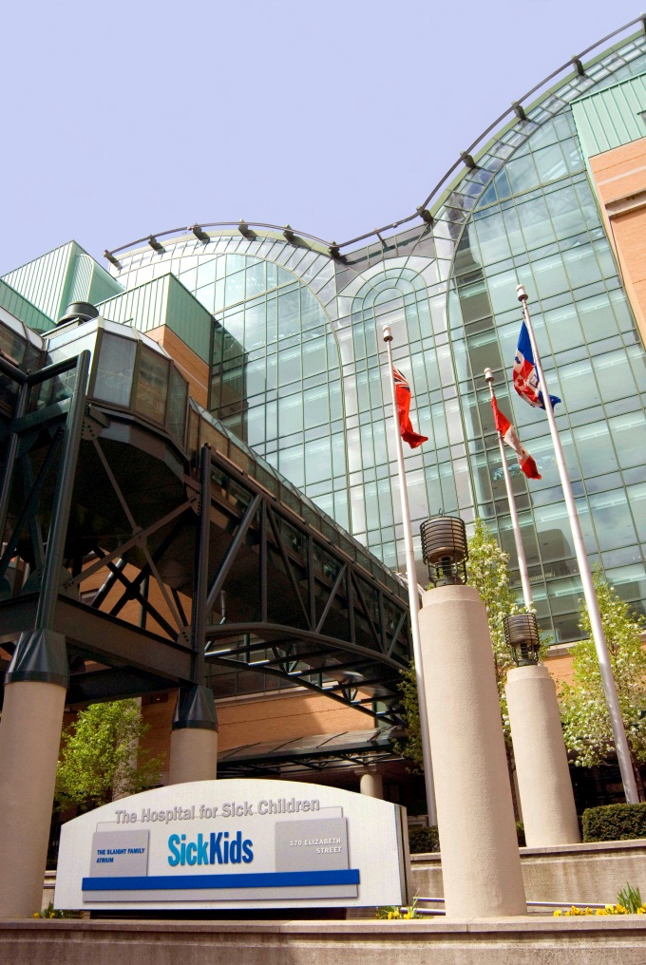
Research Institutions
Hospital for Sick Children
  Canada's most research-intensive hospital dedicated to improving children's health in Canada
  Recent historic Rogers family donation lead to creation of Toronto heart disease research centre
    $130 million from Rogers Family
    $139 million matched by Hospital for Sick Kids, U of T and University Health Network

Slide 7

Research Institutions
SNOLAB
  World’s deepest underground science lab
  Specializes in neutrino and dark matter physics
Institute for Quantum Computing
  Harnesses quantum laws of nature
  Develops powerful new technologies for future economic potential

Slide 8

Research Institutions
Fields Institute
  Collaborative mathematical research
  Professional Canadian and international mathematicians
Centre for Research and Innovation in the Bio-Economy (CRIBE)
  Transforms forest product research into operational realities

Slide 9
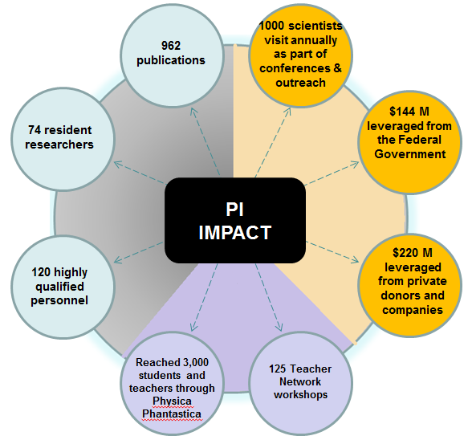
Research Institutions
Perimeter Institute for Theoretical Physics
  Devoted to the exploration of foundational theoretical physics
  World’s largest & most prominent research centres of its kind
  Provided over $126 million
  Stephen Hawking- visiting professor

Slide 10
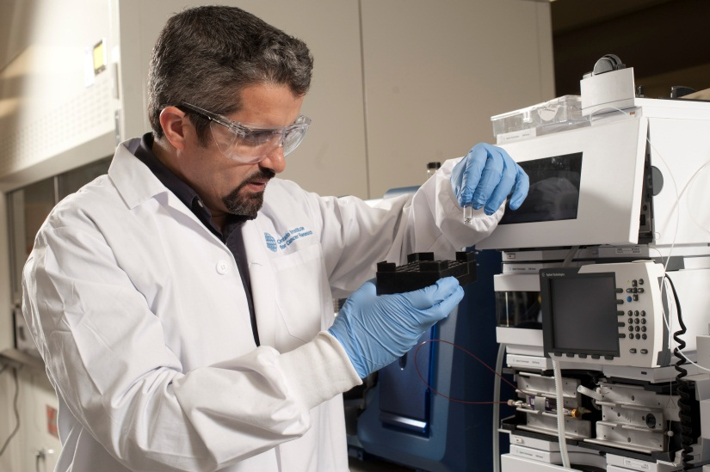
Research Institutions
Ontario Institute for Cancer Research
  Independent, not-for-profit research institution — moving new discoveries from the lab to practical applications in patient care
  MRI has committed over
  $750 million
  Supports network of:
    1,000 clinical and basic researchers
    500 post-graduate trainees

Slide 11
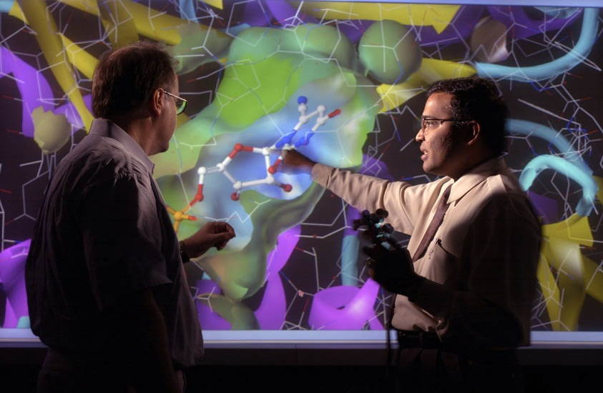
Research Institutions
Ontario Institute for Cancer Research (cont’d)
  1st institute to focus on entire spectrum of cancer issues
  Translates research results into:
    Commercialization of technologies
    Prevention
    Better patient care

Slide 12


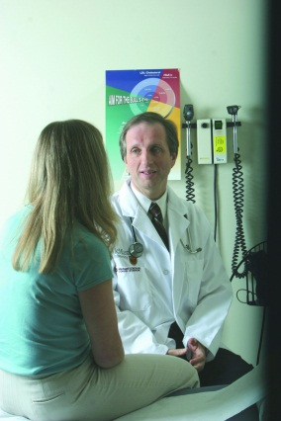
Research Institutions
Ontario Brain Institute
  Internationally recognized Centre of Excellence in brain and neuroscience research
  Over 800 researchers, 130 companies, and 100 institutions involved in neuroscience in Ontario
  Provided $115 million — will leverage $205 million
  Transforming research discoveries made in the
  lab into the marketplace and our hospitals
  Research focused on degenerative
  diseases:
    Alzheimer's, dementia, brain injury,
    depression, epilepsy, autism,
    cerebral palsy

Slide 13
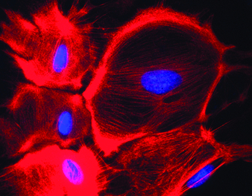
Research Institutions
Ontario Institute for Regenerative Medicine
  Stem cell discovered in Ontario
  Can use stem cells to repair, regenerate or replace diseased cells, tissues and organs
  Institute will focus on 8 disease areas:
    Heart, lung, vision, brain, diabetes,
    cancer, muscle
  Significant commercialization opportunity:
    Diagnostics, tools and products
    Global market projected $19 Billion
    by end of 2015

Slide 14

Research Institutions
Southern Ontario Smart Computing Innovation Platform
  Provided $7 million in 2012 through the Ontario Centres of Excellence
  Investigates big data solutions in the themes of water, health, energy and agile computing
  Ontario’s strong academic and research strengths were key factors in attracting IBM’s cloud computing-based research network to the province, one of only three of its kind in the world
  Collaboration between universities, OCE and SMEs is an important driver of economic growth

Slide 15
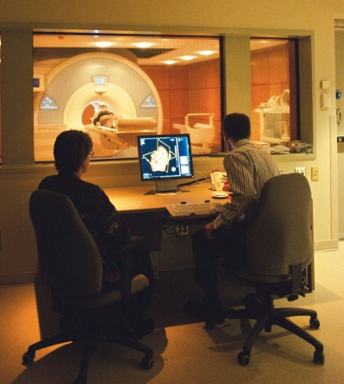
Major Industry Research & Innovation Sectors
Life Sciences
  Ontario is the largest life sciences
jurisdiction in Canada
  1,600 life science establishments
  that net:
    51% of the total revenue
    53% of the total employment
    69% of the total exports
  Ontario is 5th in North America in the number of life sciences establishments
  Generated $39 billion in revenue
  in 2012

Slide 16
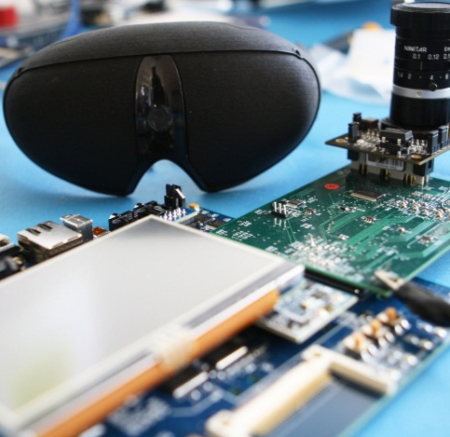
Major Industry Research & Innovation Sectors
Information and Communications Technologies (ICT)
  Ontario ranks second, after California, in
    North America in terms of the number of
    ICT establishments
  Accounted for approximately $30 billion
  of Ontario’s GDP in 2013
  Employs about 250,000 people in
  Ontario with a yearly payroll of about
  18 billion
  Exported about $6.7 billion in goods
  in 2013

Slide 17
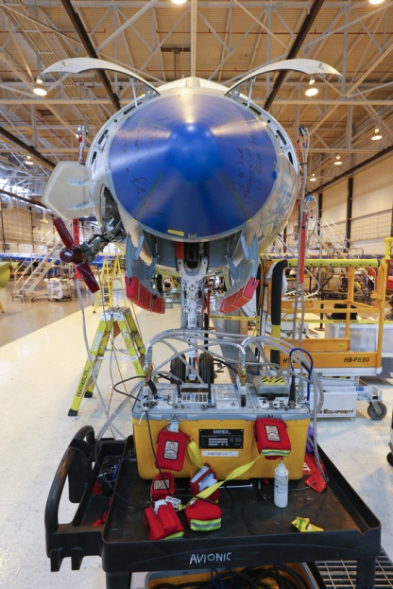
Major Industry Research & Innovation Sectors
Aerospace
  14 of the top 25 global aerospace companies have key operations in Ontario
  Generated revenues of $5.3 billion in 2013
  GDP impact of over $3 billion
  Employs close to 17,000 people
  Exports over 80 percent of it’s finished product

Slide 18
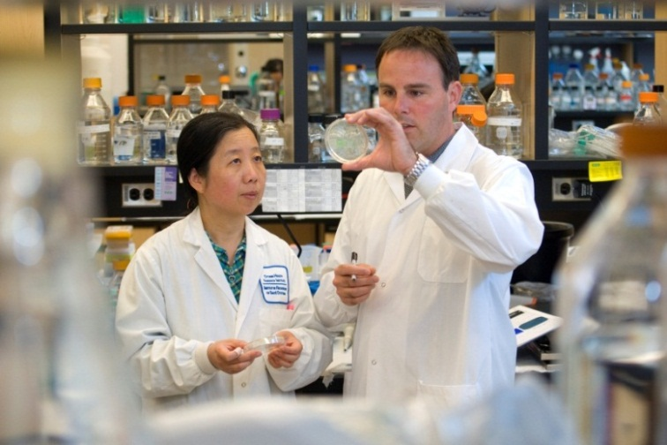
Research Funding Programs
Ontario Research Fund - Research Excellence
  Allows Ontario researchers to conduct globally significant, transformational research
  Provides 1/3 of the total project value
  2/3 being provided by institutional and private sector support
  To date, $562 million has been committed towards 143 projects

Slide 19
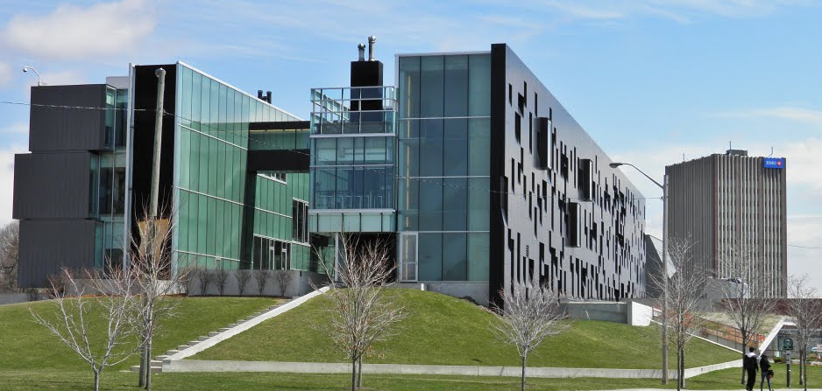

Research Funding Programs
Ontario Research Fund - Research Infrastructure
  Invests in research infrastructure to allow Ontario to help attract world-class research talent
  Ontario leverages matching federal funding through the Canada Foundation for Innovation (CFI) — each provide up to 40% of the project value, with the institution providing the remaining funding.
  $786 million has been committed
  1,908 research infrastructure
projects supported
Notes:
Image from web

Slide 20
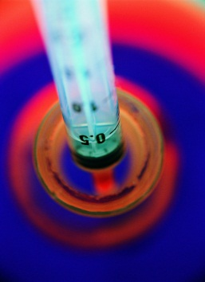
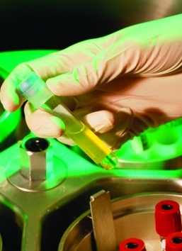

Research Funding Programs
College Industry Innovation Fund
  Investments in research infrastructure to foster partnerships with the private
  sector and support business innovation
  Example → $800,000 to establish the Centre for Healthcare Interoperability
  and Emerging Technologies at Mohawk
  College of Applied Arts and
  Technologies

Slide 21
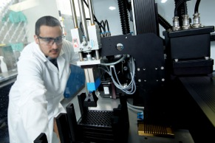
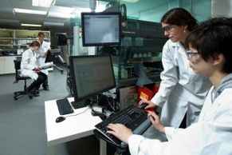
Research Funding Programs
Large Infrastructure Fund
  $496M for 194 projects
  Strategic investments in institutional research facilities
  Stimulates technology development
  Supports the growth of strong regional economies
  Example → $7.2 Million for McMaster University’s John Brennan and his research team at the Biointerfaces Institute
Notes:
Images from Biointerfaces PPT template available for download on their website

Slide 22
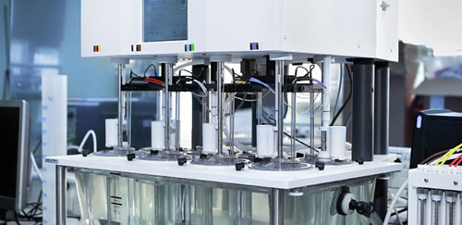
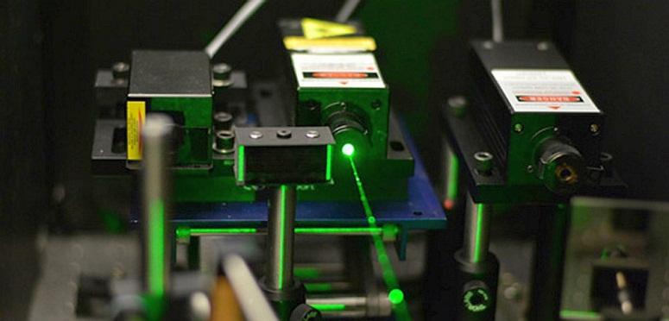
Research Funding Programs
Small Infrastructure Fund
  $290M for 1,714 projects
  Broad-based investments
  Helps institutions attract researchers
  Supports the acquisition and renewal of state-of-the-art research equipment for individual researchers
  Example → $119,999 for Dr. Karin Hinzer’s in the development of SUNLAB at the University of Ottawa
Notes:
Images from Sunlab website

Slide 23
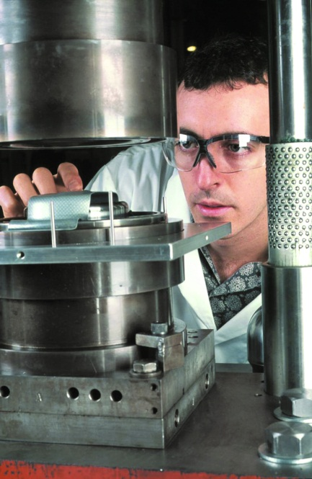
Research Funding Programs
Early Researcher Awards
  Attracts and retains top research talent
  $102 million awarded to 729 promising, recently-appointed Ontario researchers since 2005
  Trained over 12,390 highly qualified personnel through the program

Slide 24
Highlighting Research Excellence Awards
Gairdner Awards
  Rewarded to the very best biomedical research in the world
  Canada’s most outstanding and internationally recognized biomedical science awards
  Ministry has provided over $1.95M in funding to the Gairdner Foundation
Fields Medal
  The premier Canadian award for research achievements in the mathematical sciences
John C Polanyi Awards
  For individuals or teams whose Canadian-based research has led to a recent outstanding advance in the natural sciences or engineering

Slide 25

Entrepreneurship & Commercialization
Ontario Network of Entrepreneurs (ONE)
  Collaborative initiative that offers the full-spectrum of programs, services and resources available to Ontario’s entrepreneurs and businesses
  ONE is comprised of the following members:
    Regional Innovation Centres
    Post-Secondary Institutions
    Small Business Enterprise Centres
    Ministry’s Business Advisory Services Branch
  Assisted in launching almost 5,000 new
  start-ups in 2013-14
onebusiness.ca

Slide 26
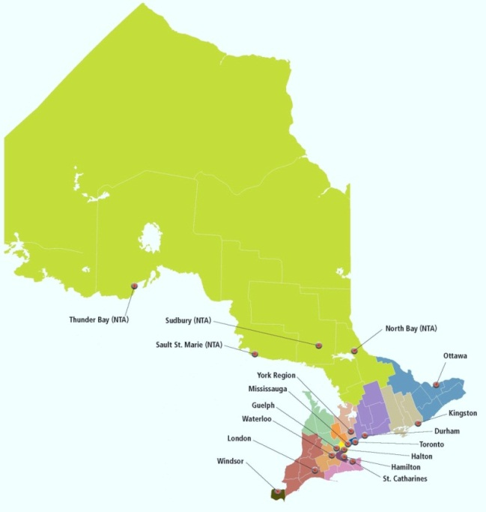
















Entrepreneurship & Commercialization
Regional Innovation Centres (RICs)
  18 “one-stop shops” for entrepreneurs across the province
  provides support to tech-based entrepreneurs and businesses

Slide 27

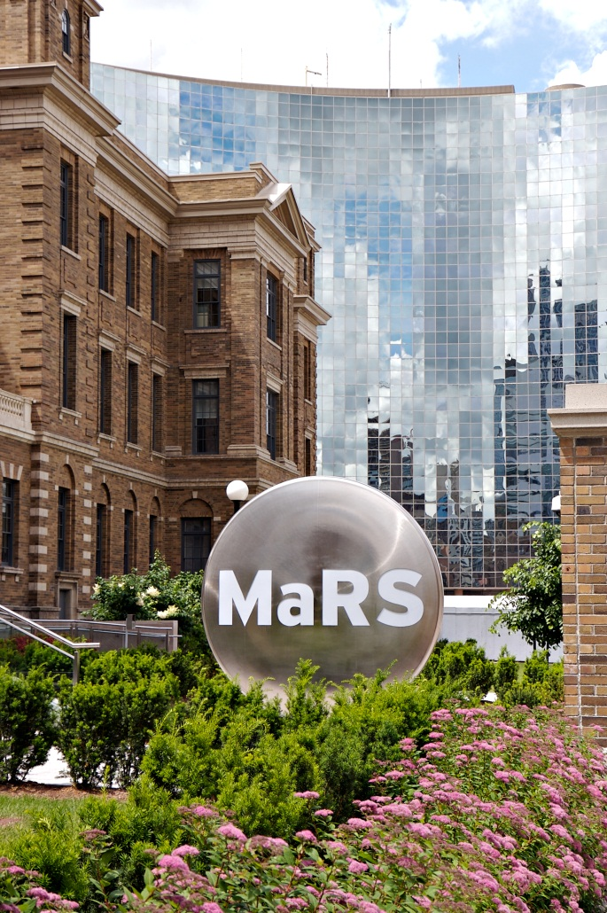
Entrepreneurship & Commercialization
Ontario’s flagship convergence centre for business, science and technology and venture capital sectors
Important partner in driving innovation, job creation and economic growth
MaRS-supported ventures have generated over 6,500 jobs to date
These jobs result in an estimated annual economic impact of $1.2 billion going forward

Slide 28

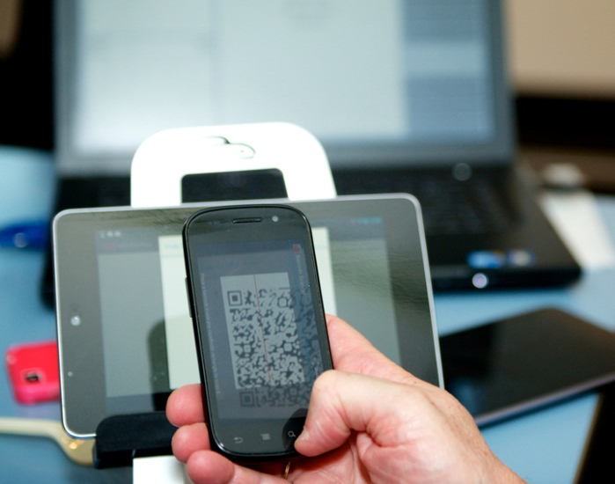
Entrepreneurship & Commercialization
Waterloo Region’s hub for the commercialization of innovative technologies
Supports tech companies
Since 2009, the province has invested over $30 million to help emerging digital media companies grow and succeed in the global market
In the 2013 Fall Economic Statement, the government committed another $15 million over the next three years

Slide 29

Entrepreneurship & Commercialization
Ontario Centres of Excellence (OCE)
  Drives the commercialization of cutting-edge research across strategic market sectors
  Fosters the training and development of the next generation of innovators and entrepreneurs
  Key partner with Ontario’s industry, universities, colleges, research hospitals, investors and governments.
oce-ontario.org

Slide 30
Entrepreneurship & Commercialization
Collaboration Voucher Program
  This program gives companies access to the expertise and knowledge at Ontario’s universities, colleges and research hospitals
  Eligible Ontario companies receive a voucher, which is a credit, that they can redeem from research institutes
  Three types:
    Voucher for Innovation and Productivity (VIP)
    Voucher for E-Business (VEB)
    Voucher for Industry Association R&D Challenge (VIA)

Slide 31

Entrepreneurship & Commercialization
Campus-Linked Accelerator
  Provides funds to post-secondary institutions to support entrepreneurship programs on-campus
  Students get advise and support to start their own businesses and become job creators
  Ontario Centres of Excellence manages the administration of the $25 million program
  42 out of 44 post-secondary institutions in Ontario now have entrepreneurship programs on campus
  Part of Ontario’s Youth Jobs Strategy

Slide 32
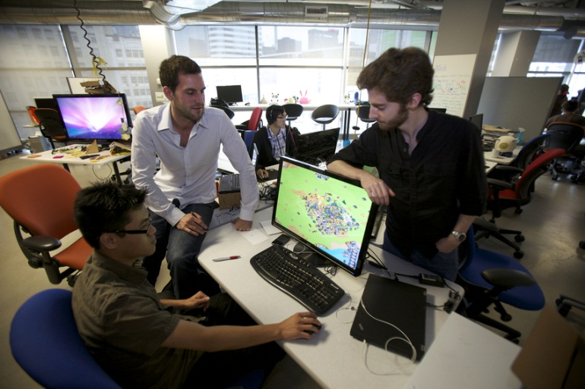
Entrepreneurship & Commercialization
  Campus-Linked Accelerator Recipient
  Digital Media Zone (DMZ)
  at Ryerson University
    Supports startups by
    connecting them with
    customers, advisors
    and entrepreneurs

Slide 33

Entrepreneurship & Commercialization
  Campus-Linked Accelerator Recipient
  University of Toronto:
    The Creative Destruction Lab — Rotman School of Management
    The Hatchery — Faculty of Applied Science and Engineering
    The Impact Centre — Faculty of Arts & Science
    University of Toronto Early Stage Technology (UTEST) — The Innovation and Partnerships Office, produced in partnership with MaRS Innovation
    U of T’s Banting and Best Centre for Innovation and Entrepreneurship — umbrella accelerator to coordinate entrepreneurship activities across the University’s three campuses.

Slide 34
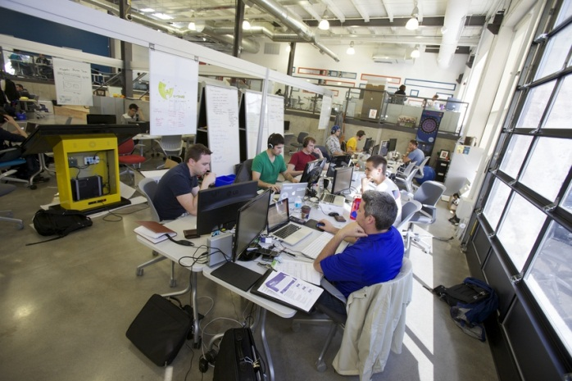
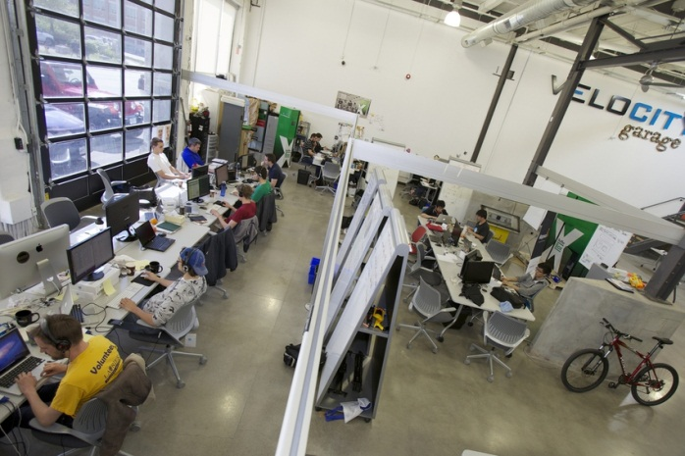
Entrepreneurship & Commercialization
  Campus-Linked Accelerator Recipient
  VeloCity at University of Waterloo
    Houses University of Waterloo students and alumni entrepreneurs
    Provides mentoring to kick-start their companies

Slide 35
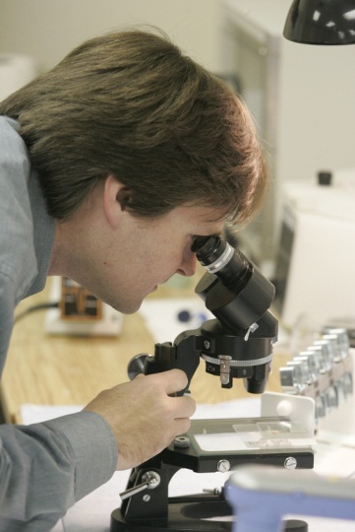

Entrepreneurship & Commercialization
Excellence in Clinical Innovation and Technology Evaluation (EXCITE)
  Program designed to accelerate the evaluation of
  health technologies
  Focused on products with commercialization
  potential that align with health system priorities
  and patient needs
  Program managed by MaRS in partnership with:
    Ontario Health Technology Advisory Committee (OHTAC)
    Ministries of Health and Long-Term Care, Research and Innovation and Council of Academic Hospitals of Ontario
    More than 10 leading academic health institutions across Ontario Industry

Slide 36

Entrepreneurship & Commercialization
Clinical Trials Ontario
  Provides a better approach for ethics review and administrative processes for clinical trials
  Initiative will lead to:
    Improved patient recruitment,
    Shorter trial times and
    Makes Ontario a more attractive destination for industry-sponsored clinical trial investments

Slide 37

Entrepreneurship & Commercialization
Health Technology Exchange (HTX)
  Provides financing to emerging and established Ontario-based companies
  Develops, produces and commercializes innovative
market-leading advanced health technologies

Slide 38

Commercialization Funding
Investment Accelerator Fund
  A seed-stage fund- helps companies expand operations
  Managed by MaRS
  Provides up to $500,000 in funding to assist companies in bringing their products and services to market
  Over $45 million invested into 92 companies to-date.
  Helped companies grow and attract over $375 million in follow-on investment
  Created/retained 1300 jobs

Slide 39

Commercialization Funding
Business Acceleration Program
  Over $45 million disbursed to date plus $5 million to the youth program
  Includes:
    Market intelligence programs
    Funding programs
    Advisory services for technology-based entrepreneurs
    Managed by MaRS

Slide 40
Commercialization Funding
Ontario R&D tax Incentive Program
  Available to qualified businesses of all sizes
  The greatest cost advantage for R&D in the G7
Ontario Tax Exemption for Commercialization
  Tax refund available to eligible start-ups incorporated between March 2008 and March 2012
  Focus on commercializing intellectual property developed at Canadian universities and colleges
  Refunds available for first 10 taxation years for start-ups
  Applied to: advanced health, bioeconomy, telecommunications, computer or digital technologies production
Ta x

Slide 41

Venture Capital
Ontario Venture Capital Fund
  $205 million fund managed by Northleaf Capital Partners
  Includes $90 million from the province that invests in Ontario venture capital and growth equity funds
  Supports innovative, high growth companies

Slide 42

Venture Capital
Innovation Demonstration Fund
  Helps companies develop promising green technologies and get them to market
  Focus on pilot-scale technology demonstration projects
  Invested $98 million to-date
  Attracted $249 million in further investments
  1200 high value jobs created

Slide 43

Venture Capital
Northleaf Venture Catalyst Fund
  Partnership between Ontario, the Government of Canada and private investors
  Ontario and the federal government have each committed up to $50 million to the fund which has a current value of over $233 million
  Makes investments in other venture capital funds and also makes direct investments into companies

Slide 44
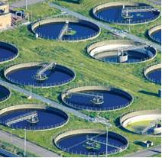
Venture Capital
Ontario Emerging Technologies Fund
  $250 million fund co-invests alongside qualified investors into innovative, high-growth, private Ontario companies
  Managed by the Ontario Capital Growth Corporation
  Designed to respond to the challenges faced in raising capital by innovative, private, Ontario-based companies
  Reinvests any returns from its investments
  Sector Focus:
    clean tech
    life sciences
    advanced health technologies
    digital media
    ICT

Slide 45
Venture Capital
Ontario Capital Growth Corporation
  Manages the interest of the Government of Ontario in the limited partnership with the Ontario Venture Capital Fund LP (OVCF) such as:
    Ontario Venture Capital Fund
    Northleaf Venture Catalyst Fund
    Ontario Emerging Technologies Fund

Slide 46

Venture Capital
Angel Network Program
  Connects high-potential entrepreneurs with angel investors
  Provides both capital and business experience to promising start-up companies

Slide 47

International Collaboration
International Research Collaboration
  Ontario has Memorandums of Understanding with Israel, Germany, India, Singapore and China
  Building international collaboration is key for Ontario to remain competitive.
  Establishing formal ties with foreign governments
  Exchange information on areas of mutual interest, profile areas of expertise
  Establish contacts with local stakeholders within the research community

Slide 48


Provincial Collaboration
Ontario-Québec Life Sciences Corridor
  Supports industry-academic collaborations
  Focus on innovative tools and technologies to improve and accelerate the drug discovery process

Slide 49

Provincial Collaboration
Alberta Innovates Technology Futures — OCE partnership
  Draws on academic expertise to address challenges faced by industry
  Both provinces are providing up to $4 million with up to $4 million matched by industry partners in both provinces.
Notes:
Image from OCE website

Slide 50


Our Successes
Xagenic
  Molecular diagnostics company
  Received funding from both the Ontario
  Venture Capital Fund and the Ontario
  Investment Accelerator Fund
  Its technology promises to transform the way infectious diseases are diagnosed — not in a lab, but a doctor’s office
  Developing a fully-automated molecular diagnostic platform that will enable lab-free testing with a time-to-result of 20 minutes
  This is a multi-billion dollar opportunity that could improve the health of people around the world
Notes:
Image from Xagenic website

Slide 51
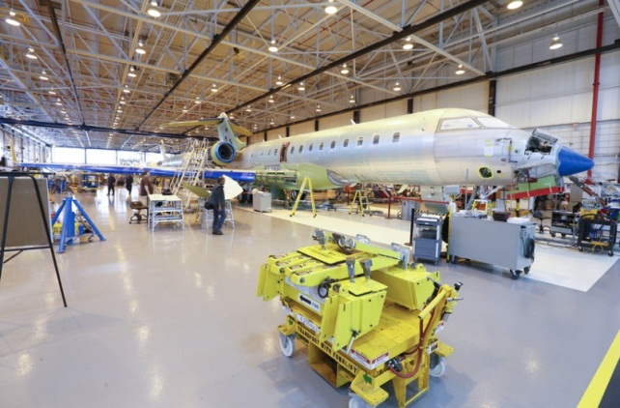
Our Successes
Bombardier and Centennial College
  Ontario invested $497,000
  Trains 83 youth in a 16-week program to meet hiring needs for Bombardier and other aerospace firms
  Bombardier has indicated that it will interview and consider hiring graduates with starting salaries of $65,000 — those not hired will be referred to other industry partners

Slide 52
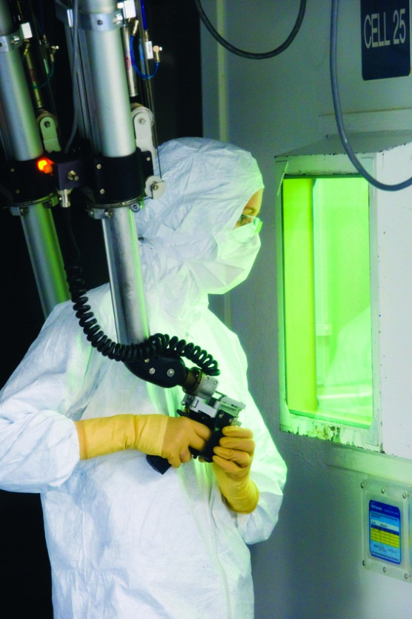
Advisory Boards
Ontario Health Innovation Council (OHIC)
  Advises the government on the best ways to expand the health technology industry via:
    development
    commercialization
    adoption
  Identifies opportunities for evidence-based
innovation and strategies in health care to:
    Facilitate technological innovations
    Strategically use the provincial purchasing power
    Expand the adoption of innovative new technologies

Slide 53
Advisory Boards
Ontario Research Fund Advisory Board
  Responsible for making recommendations to the Minister on which projects should be funded
  Composed of members who have expertise in research and/or commercialization
  Recommendations are made on the basis of assessments made by expert peer review panels

Slide 54

Future Initiatives
Super Computing and Big Data
  Currently working with Compute Ontario and stakeholders to develop a big data advanced computing strategy that will:
    Integrate research community
    Support the development of big data talent
    Incubate high-growth start-ups
Notes:
Image from???

Slide 55

Ministry of Research & Innovation
Overview
  Ministry of Research and Innovation has 107 full-time employees
  Budget allocation for 2014-15 is $561.5 million

Slide 56
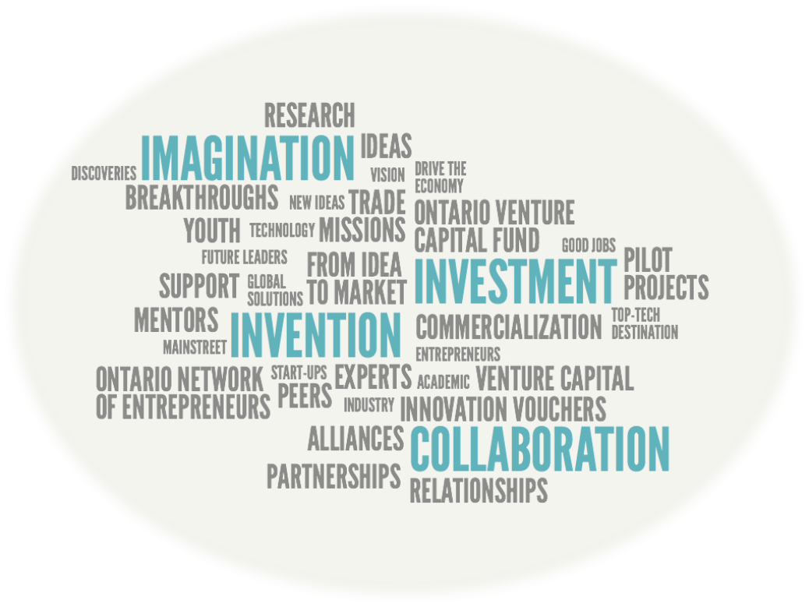
“Imagination is the beginning of innovation!”

Slide 57
Thank you!
Any Questions?

